Slide 1

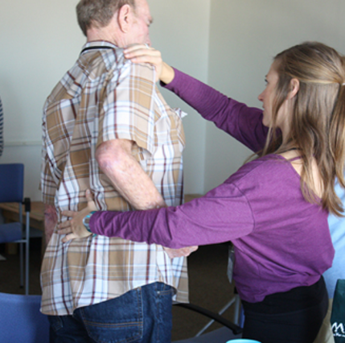

Visualization of Research in Occupational Therapy
Based on 1982-2016 Data from the American Occupational Therapy Foundation

Slide 2
Cumulative Network of Diagnosis vs. Primary Investigators
1982-2017
The dataset was thoroughly cleansed, with duplicate records removed. The referential integrity was enforced on the clean dataset. The Primary Investigator was associated with the Diagnosis Descriptions relative to the respective Research Projects. The extracted dataset was cumulatively sliced by seven years from 1982 to 2017 inclusively.
For every time slice the number of nodes tripled from 18 in 1989 to 221 in 2017.
From 1982 to 1996 the research was concentrated on Amputations or limb loss, Other, and Dementia or Alzheimer's disease Diagnosis with M. Lowler and J.Rogers consistently leading the research in the respective areas, including on the Other Diagnosis.
From 2003 to 2017 the field of research expanded significantly and started moving to the areas of Autism spectrum disorders, lead by Teresa A. May-Benson, that is strongly connected to Sensory integration/processing disorders research community that was headed by Patricia Davies. The third largest, Stroke research community, is connected to the Other diagnosis by Kenneth Ottenbacher and is engaged in collaborations with Brain injury and disorders and Cerebral Palsy.
Two more dispersed communities were identified. The first consisted of the area of diagnosis associated with various body injuries such as Spinal Cord, Upper Extremities and Musculoskeletal injuries with Corey McGee and Mary Jane Mulcahey leading the field. The second emerging community consists of Mental illness, Diabetes and Cardiopulmonary conditions field lead by Christine Helfrich.

Slide 3
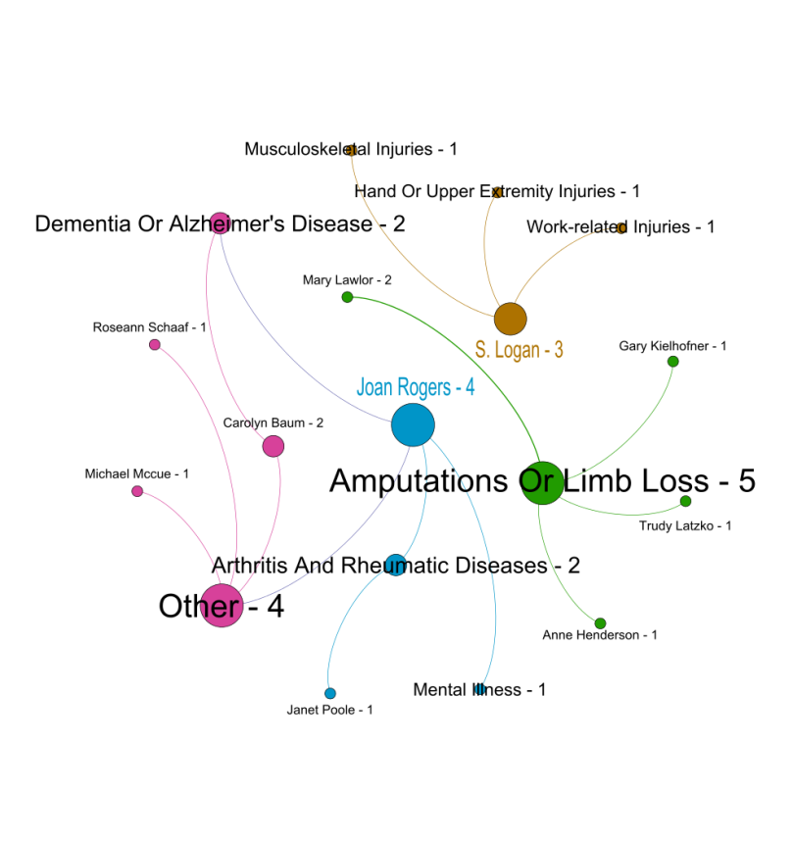
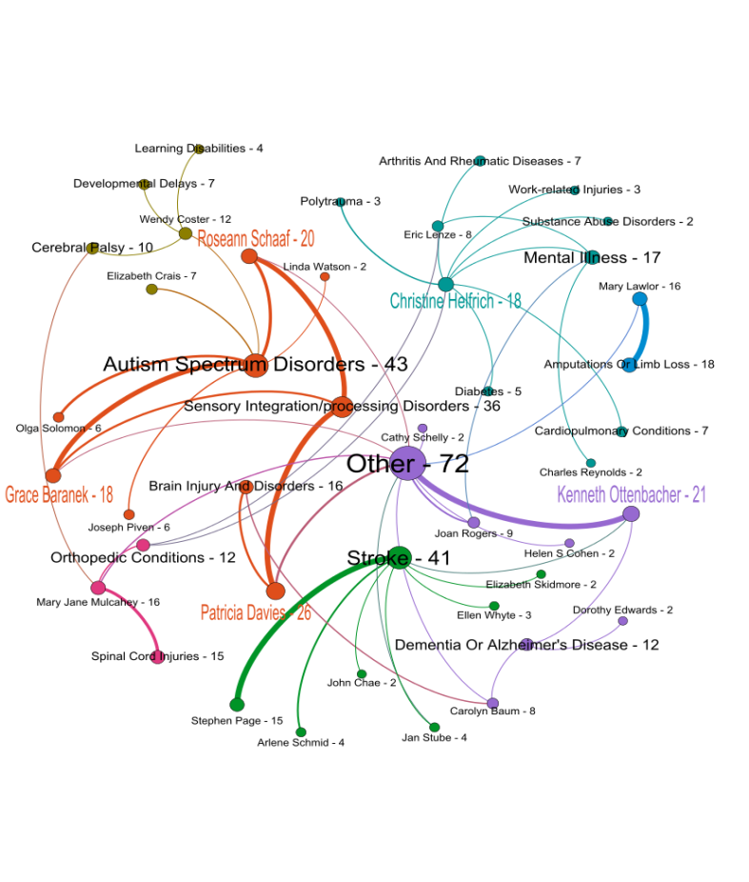
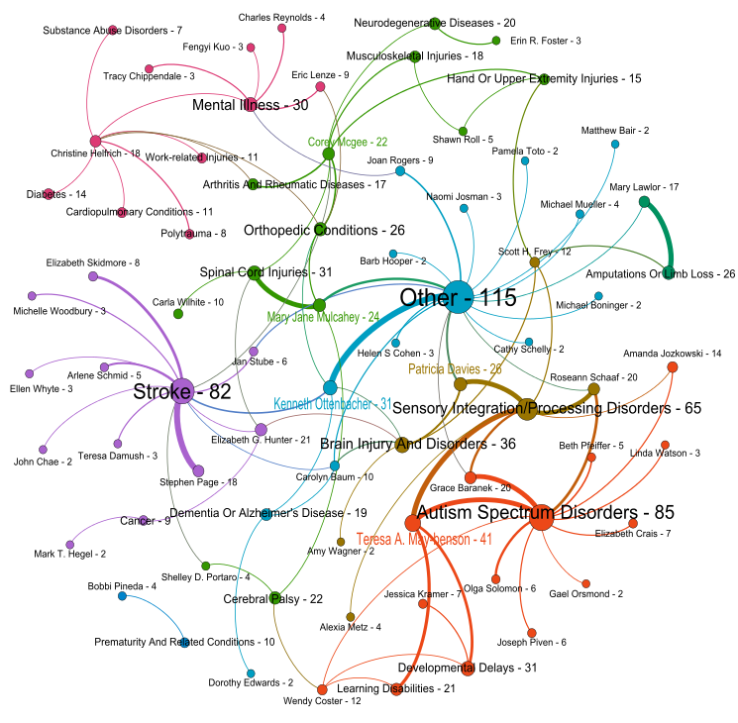
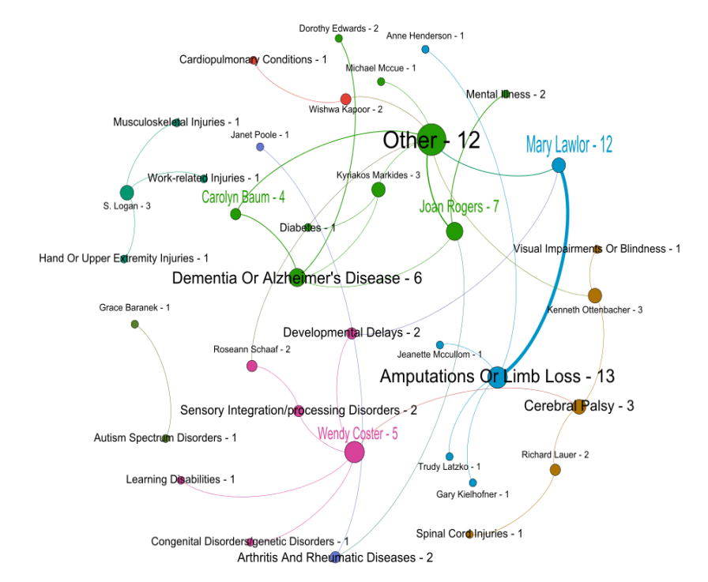
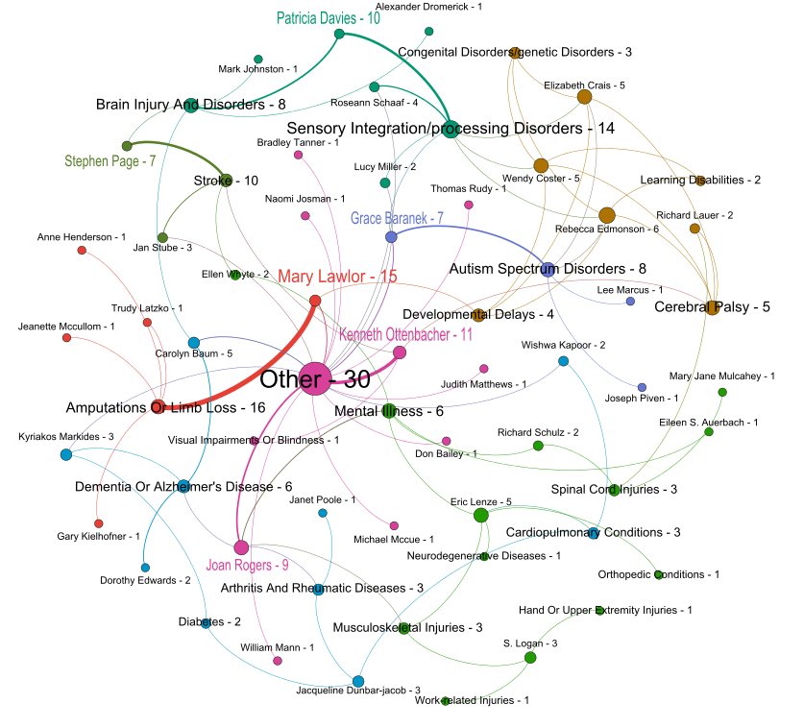
1982-1989
Cumulative Network of
Diagnosis vs. Primary Investigators
1982-2017
1982-2010
1982-1996
1982-2003
Nodes and Edges colorized by communities
Nodes , Node Labels and Edges sized by number of projects
Labels depict PI name or Diagnosis and a number of associated projects
Top 5 PIs with the most number of research projects colored

Slide 4
Cumulative Network of Diagnosis vs. Agenda
1982-2017
The Agenda vs. Diagnosis dataset was cumulatively sliced by seven years from 1982 to 2017 inclusively.
Number of projects steadily grew from 7 in the period of 1982-1989 (to 22, to 75, to 148) to 278 in the period of 1982-2017. Started with only eight Diagnoses, the field significantly expended to 29 Diagnoses by 2017.
Basic Research, Assessment/measurement and Intervention-preventive Agendas were strongly represented by majority of the associated research projects
After 1996 a new agenda item (Research Training) was introduced.
Initially, Basic Research, Assessment/measurement agendas were strongly linked with Amputations or limb loss, Other, and Dementia or Alzheimer's disease Diagnoses .
After 1996 Autism spectrum disorders, Sensory integration/processing disorders and Stroke Diagnoses associated with Intervention-preventive Agenda started playing prominent role in the OT community

Slide 5
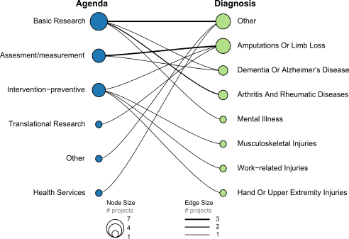
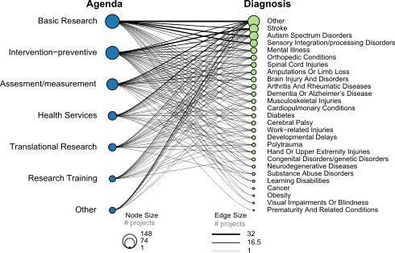
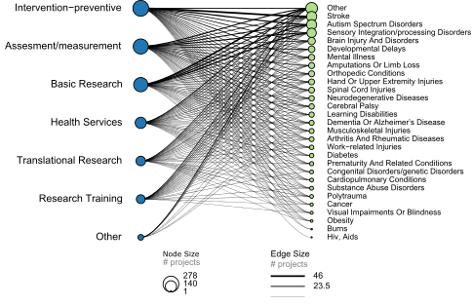
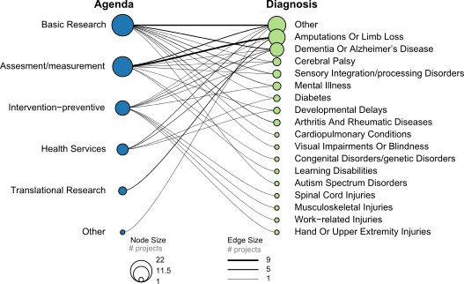
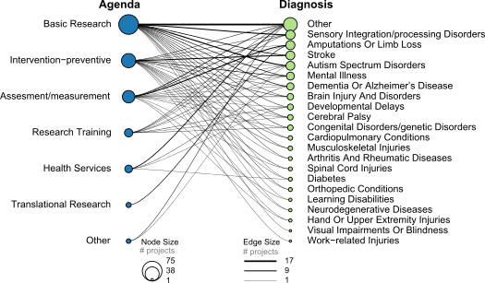
1982-1989
Cumulative Network of
Agenda vs. Diagnosis
1982-2017
1982-2010
Agenda Diagnosis
1982-1996
1982-2003

Slide 6

Cumulative Time Slice
1982-1989
Primary investigator -diagnosis
Agenda-diagnosis

Slide 7

Cumulative Time Slice
1982-1996
Primary investigator -diagnosis
Agenda-diagnosis

Slide 8
Cumulative Time Slice
1982-2003
Primary investigator -diagnosis
Agenda-diagnosis

Slide 9

Cumulative Time Slice
1982-2010
Primary investigator –diagnosis
(2 and more projects only)
Agenda-diagnosis

Slide 10
Cumulative Time Slice
1982-2017
Primary investigator –diagnosis
(2 and more projects only)
Agenda-diagnosis

